Slide 1

Missouri State Highway Patrol
Missouri Uniform Crash Report (MUCR) & MUCR Preparation Manual Revision

Slide 2
Welcome and Introductions
Mandy Kliethermes - Assistant Director, Patrol Records Division, MSHP
Russ Dunwiddie - Temporary Professional, Patrol Records Division, MSHP

Slide 3
Agenda
Define New MUCR Data Fields and Data Attribute Values
Discuss the MUCR Data Fields and Data Attribute Values Added, Modified, or Removed
Overview of the MUCR Revision Process and Stakeholders Involved

Slide 4
Objective
Upon completion of this block of training, the attendee should have a clear understanding of the changes to the Missouri Uniform Crash Report (MUCR) and MUCR Preparation Manual as well as the new reporting requirements.

Slide 5
Outline of Revision Process and Stakeholders Involved

Slide 6
Why Revise the Crash Report?
Technology changes:
  Increase in autonomous vehicles that control steering, braking, acceleration, etc.
  Increase in non-motorists on Missouri’s trafficways and the variety of personal conveyances they utilize
Changes in data needs for improved analysis:
  Evolving laws such as marijuana use
  Work zones crashes
  Non-motorist crashes

Slide 7
Why Revise the Crash Report?
Improve the quality and robustness of crash data
New Edition of Model Minimum Uniform Crash Criteria (MMUCC) .

Slide 8
What is MMUCC?
MMUCC is a publication from the U. S. Department of Transportation, National Highway Traffic Safety Administration (NHTSA).
It is a minimum set of recommended motor vehicle crash data elements and their attributes that States can consider for inclusion on their crash report and in their data system.

Slide 9
What is MMUCC?
The latest version of MMUCC 5th Edition (2017) was used for the MUCR revision.

Slide 10
MUCR Revision Process
The Missouri State Highway Patrol, Patrol Records Division, director and assistant director reviewed the MMUCC 5th Edition when it was published.
In 2017 the NHTSA completed a mapping of MMUCC 5th Edition data elements and attributes to the 2012 MUCR and Statewide Traffic Accident Records System (STARS) and submitted a mapping report to the MSHP and MoDOT.

Slide 11
MUCR Revision Process
After review of the mapping report, the MSHP, Patrol Records Division, director and assistant director conversed with personnel from the MoDOT, Highway Safety and Traffic Division, and concluded a revision to the MUCR was warranted.
In November 2019 the Missouri STARS Committee began meeting to discuss revisions to the MUCR.

Slide 12
Missouri STARS Committee
Cape Girardeau Police Department
Federal Highway Administration
Federal Motor Carrier Safety Admin.
Jefferson City Police Department
Kansas City Police Department
Platte County Sheriff’s Department
Missouri Dept. of Health & Senior Serv.
Missouri Department of Revenue
Missouri Department of Transportation
Missouri Safety Center
Missouri State Highway Patrol
National Highway Traffic Safety Admin.
St. Charles County Police Department
St. Joseph Police Department
St. Louis County Department of Trans.
St. Louis County Police Department
St. Louis Metropolitan Police Dept.
Springfield Police Department
Town and Country Police Department

Slide 13
Challenges
Inputs from a wide range of stakeholders
Competing demands
Time intensive

Slide 14
Decision Principals Used
Schedule driven
Compromise
Produce positive improvement to the crash report form and data
Focus on expected benefits of any change to avoid making changes simply because they might be useful
MMUCC 5th Edition followed by default

Slide 15
Decision Process Used
Is there a specific, important need not met with the current crash report?
Is the requested change in line with MMUCC recommendations?
Is the requested change redundant with other fields on the crash report?

Slide 16
Decision Process Used
Is the requested change compatible with other fields on the crash report?
Can the crash investigating officer confidently and consistently complete the new/revised crash report field?
Is it clear how historic data could be associated to a modified field or attribute?

Slide 17
Decision Process Used
Can the data be found elsewhere and linked to the crash data repository?
Requests for new fields and attributes were not considered unless deemed essential.

Slide 18
Changes to the MUCR & MUCR Preparation Manual
Pages i-vii, revised Missouri Uniform Crash Report example.

Slide 19
General Information
Pg. 5, item I. Introduction, changed the Statewide
  Traffic Accident Records System to Missouri Crash Analysis Reporting System (MOCARS).
The revised Missouri Uniform Crash Report and MOCARS will be implemented January 1, 2024.

Slide 20
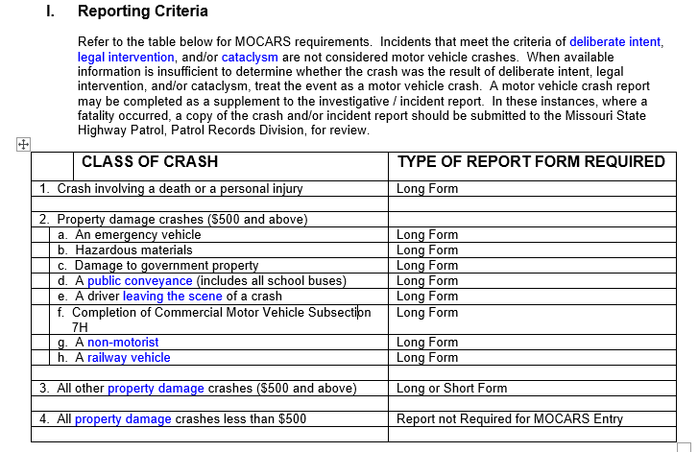
General Rules
Pg. 7, item I. Reporting Criteria, changed item 2.g. from Pedestrian to Non-motorist.

Slide 21
Glossary of General Terms & Definitions Pg. 10
ACTIVITY AREA – New term.
ADVANCED WARNING AREA – New term.
BICYCLE FACILITY – New term.
BICYCLE LANE – New term.
DISABLING DAMAGE – New term.
DRIVER – Revised to match MMUCC.

Slide 22
Glossary of General Terms & Definitions
EMERGENCY REFERENCE MARKER (ERM) – Modified the definition by removing “Only ERMs located on interstates can be used.”
LEFT THE SCENE – Removed the reference of a person commits the crime of leaving the scene as well as the reference to Section 577.060, RSMo.
Motor Vehicle In Transport – Revised definition by removing “in readiness for motion.”

Slide 23
Glossary of General Terms & Definitions
NON-MOTORIST – New term.
NUMBER OF VEHICLES INVOLVED IN A CRASH – Changed the definition to the number of motor vehicles and railway vehicles directly involved in the crash before the situation stabilizes. Also, clarified working motor vehicles are included when engaged in a harmful event with a separate motor vehicle in transport during the unstabalized event(s).

Slide 24
Glossary of General Terms & Definitions
OTHER NON-MOTORIST – New term.
OTHER TRANSPORT DEVICE - Several changes, see definition.
PEDALCYCLE – Revised definition.
PEDALCYCLIST – New term.
PROPERTY DAMAGE (PDO) – New term.
ROADSIDE – New term.

Slide 25
Glossary of General Terms & Definitions
SAFETY DEVICE – Changed the previous reference of pedestrian to non-motorist.
SHARED-USE PATH OR TRAIL – New term.
VEHICLE – Changed to any motor vehicle or railway vehicle.
WORK ZONE-RELATED – New term.

Slide 26
Section 1 – GENERAL CRASH INFORMATION
Pg. 28, item h., NO. VEH. INVOLVED – The number of motor vehicles as well as railway vehicles directly involved in a motor vehicle crash before the situation stabilizes. Working motor vehicles are included when engaged in a harmful event with a separate motor vehicle “in transport.” Any subsequent contact after the situation stabilizes constitutes a separate crash.
Notes:
Purpose – Added to meet MMUCC compliance (C3. Crash Date and Time)
Added field with definition with "unknown" attribute "N/A".
Definitions
DATE OF ROADWAY CLEARANCE – Enter the date that all lanes are available for traffic flow.
TIME OF ROADWAY CLEARANCE – Enter the time that all lanes are available for traffic flow.

Slide 27
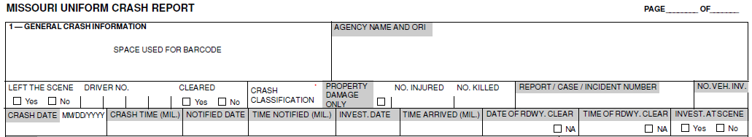
Section 1 – GENERAL CRASH INFORMATION
Pgs. 28 & 29, items o. and p., added fields DATE OF RDWY. CLEAR and TIME OF RDWY. CLEAR. (From MMUCC)
Notes:
Purpose – Added to meet MMUCC compliance (C3. Crash Date and Time)
Added field with definition with "unknown" attribute "N/A".
Definitions
DATE OF ROADWAY CLEARANCE – Enter the date that all lanes are available for traffic flow.
TIME OF ROADWAY CLEARANCE – Enter the time that all lanes are available for traffic flow.

Slide 28
Section 1 – GENERAL CRASH INFORMATION: CRASH TYPE
Pg. 29, item ii., 4., Jackknife – Modified the definition.
Pg. 29, item ii., 5., Fell / Jumped From M/V – Modified the definition.
Pg. 29, item ii., 6., Cargo / Equipment Loss / Shift – Clarified that occupants are not considered cargo.

Slide 29
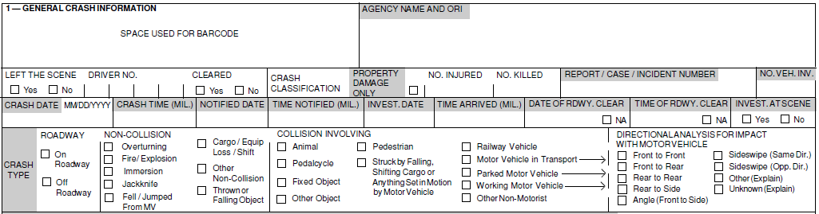
Section 1 – GENERAL CRASH INFORMATION: CRASH TYPE
Pg. 30, item 8., Thrown / Falling Object - New attribute and definition. (From MMUCC)

Slide 30
Section 1 – GENERAL CRASH INFORMATION: CRASH TYPE
Pgs. 30 & 31, item iii., 2., Pedalcycle – Modified the definition.

Slide 31
Section 1 – GENERAL CRASH INFORMATION: CRASH TYPE
Pg. 30, item iii., 1., Animal – This includes only live animals. Dead animals are considered “other objects.” An animal being ridden or an animal drawn conveyance with a person(s) is considered an “other non-motorist.” An animal drawn conveyance not occupied by a person(s) is considered an “other object.”

Slide 32
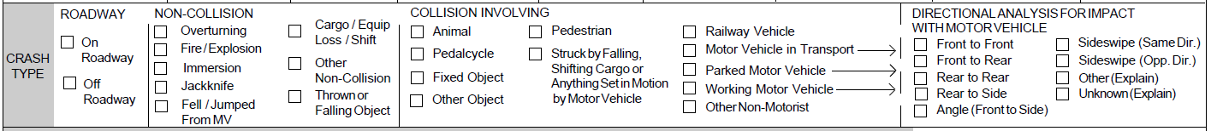
Section 1 – GENERAL CRASH INFORMATION: CRASH TYPE
Pg. 33, item 6., Struck by Falling, Shifting Cargo or Anything Set in Motion by Motor Vehicle - New attribute value and definition. (From MMUCC.)

Slide 33
Section 1 – GENERAL CRASH INFORMATION: CRASH TYPE
Pg. 33 & 34, item 9., Parked Motor Vehicle – Revised example “iv.” … a truck stopped at the exit to a gas station and waiting to enter the roadway.

Slide 34
Section 1 – GENERAL CRASH INFORMATION: CRASH TYPE
In regard to Crash Type – Collision Involving, we removed “Animal Drawn Veh. / Animal Ridden Trans. When these are involved in a motor vehicle crash as the first harmful event, they will now be classified as “Other Non-Motorist.”

Slide 35
Section 1 – GENERAL CRASH INFORMATION: CRASH TYPE
Pgs. 35 & 36, item 11., Other Non-Motorist - New attribute value and definition. (From MMUCC.)

Slide 36
Section 1 – GENERAL CRASH INFORMATION
Pgs. 36 - 39,item iv., Directional Analysis For Impact with Motor Vehicle – Removed Falling / Shifting Cargo (Set in Motion by M/V). These impacts will be marked “Other.” We also noted that Angle is front to side impact.

Slide 37

Section 1 – GENERAL CRASH INFORMATION
Pg. 40,
Item t., Evidentiary Photos Taken – Modified the definition.
Item u., Evidentiary Video Taken - New field.

Slide 38
Section 2 - LOCATION
Pg. 42 bottom of page, added the following route designations:
  FWS – Fish and Wildlife
  NPS – National Park Service
  COE – Core of Engineers
  NFS – National Forest Service
  PK – Park Road

Slide 39
Section 2 - LOCATION
Pg. 44, item j. i., added to the sentence "in the same county” as the “On” street or highway.

Slide 40
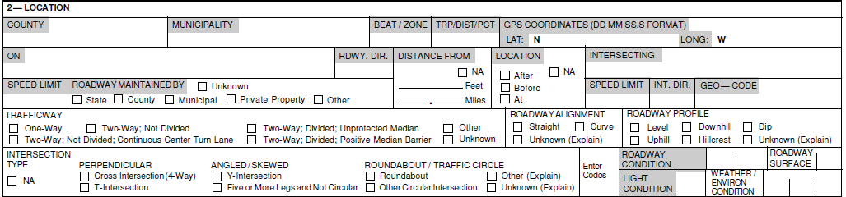
Section 2 - LOCATION
Pg. 44, item j. i., Intersecting Roadways – We added the following sentence: “Location of crashes to or from unnamed roadways, such as unnamed private roads, should be avoided.”

Slide 41
Section 2 - LOCATION
Pg. 47, item l., changed Road Maintained By to Roadway Maintained By to be consistent with the definition. The definition did not change.

Slide 42
Section 2 - LOCATION
Pg. 49, item v., Two-Way; Divided; Positive Median Barrier -Added the wording … two roadways are divided by any protective concrete, metal, or other type of longitudinal manufactured barrier.

Slide 43
Section 2 - LOCATION
Pgs. 50 & 51, grouped the various intersection types into PERPENDICULAR, ANGLED / SKEWED, and ROUNDABOUT / TRAFFIC CIRCLE. (From MMUCC.)

Slide 44
Section 2 - LOCATION
Pgs. 49 & 51, fields Road Alignment, Road Profile, Road Condition, and Road Surface, were changed to Roadway to be consistent with the attribute definitions.

Slide 45
Section 2 - LOCATION
Pg. 51, fields Roadway Condition, Light Condition, Roadway Surface, Weather / Environmental Conditions changed from checkboxes to entry of numerical codes.

Slide 46
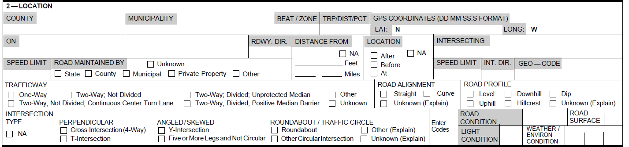
Section 2 - LOCATION
Pg. 51, item w., changed the field from Weather Condition to Weather / Environmental Condition.

Slide 47
SECTION 3 – DAMAGE TO PROPERTY OTHER THAN VEHICLES
Pg. 52, item III., added a list of inclusions and exclusions in relation to Damage to Property Other Than Vehicles.
Includes (but is not limited to):
Injury to domestic animals that have monetary value.
Damage to trees, shrubs, crops, or property of determinable value.
Government property such as highway signs, guard rails, lamp poles, etc.

Slide 48
SECTION 3 – DAMAGE TO PROPERTY OTHER THAN VEHICLES
Includes (but is not limited to):
Damage to a pedalcycle with or without a pedalcyclist. (Pedalcycle with pedalcyclist is no longer recorded as a vehicle and driver. Info on the damaged pedalcycle will now be recorded in Section 3. and the pedalcyclist in Section 5.)
Damage to a pedestrian conveyance with or without a pedestrian.

Slide 49
SECTION 3 – DAMAGE TO PROPERTY OTHER THAN VEHICLES
Includes (but is not limited to):
Injury to an animal being ridden by a person.
Injury and damage to an animal drawn conveyance with or without a person(s).
(Animal with a rider or animal drawn conveyance with a driver is no longer recorded as a vehicle and driver. Info on the injured animal and damaged conveyance will now be recorded in Section 3 and the occupants in Section 5.)

Slide 50
SECTION 3 – DAMAGE TO PROPERTY OTHER THAN VEHICLES
Includes (but is not limited to):
Damage to an “other transport device” occupied by an “other non-motorist” from a m/v crash.
  Examples:
  Riding lawn mower mowing off the trafficway.
  Farm tractor engaged in planting a field.
  Bulldozer engaged in excavating off the trafficway.

Slide 51
SECTION 3 – DAMAGE TO PROPERTY OTHER THAN VEHICLES
Excludes:
Property that is in or on a motor vehicle or railway vehicle.
Property that has fallen from a motor vehicle or railway vehicle in transport, but has not come to rest.

Slide 52
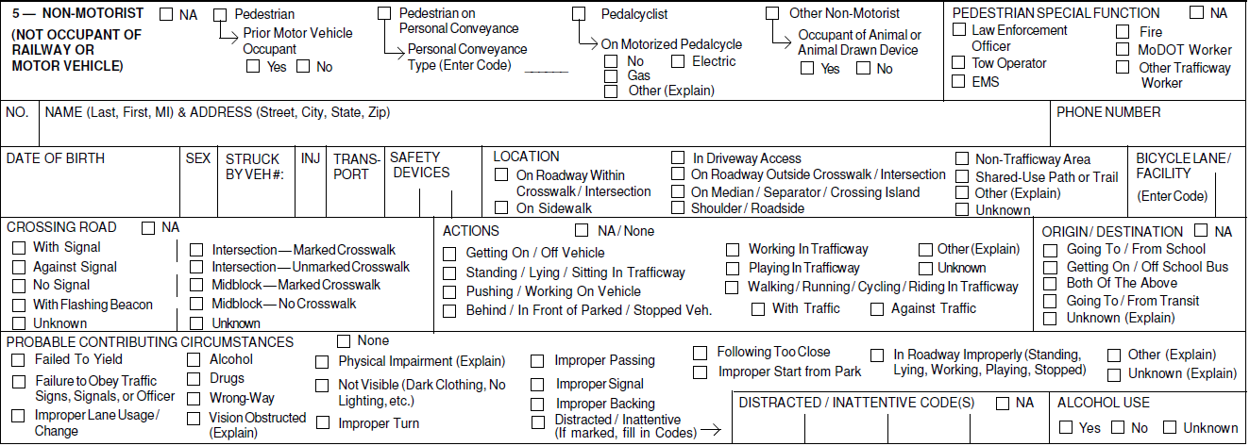
Section 5 – Non-Motorist (Not Occupant of Railway or Motor Vehicle)
Pg. 54, Section V., changed Section 5 from PEDESTRIAN to NON-MOTORIST (NOT OCCUPANT OF RAILWAY OR MOTOR VEHICLE). (MMUCC)

Slide 53
Section 5 – Non-Motorist (Not Occupant of Railway or Motor Vehicle)
A non-motorist includes pedestrians, pedalcyclists, and other non-motorists.

Slide 54
Section 5 – Non-Motorist (Not Occupant of Railway or Motor Vehicle)
Reminder, motor vehicle crashes involving pedalcyclists or animal drawn vehicles / animal ridden for transport will no longer be recorded in Section 7 – DRIVERS, VEHICLES, OWNERS, & OCCUPANTS. They will be recorded in Sections 3 and 5.
Occupants of motor vehicles will still be recorded in Section 7 – DRIVERS, VEHICLES, OWNERS, & OCCUPANTS and occupants of railway vehicles will still be recorded on the Railway Vehicle Crash Continuation / Supplement form.

Slide 55
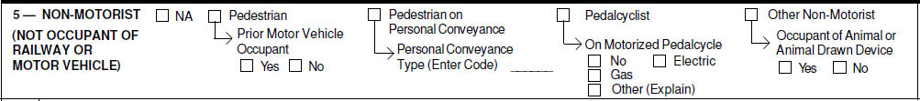
Section 5 – Non-Motorist (Not Occupant of Railway or Motor Vehicle)
Pg. 54, item a., NA - if no non-motorist is involved, mark the “NA” box.
Pgs. 54 – 55, items b. – e., Mark the appropriate box if the non-motorist is a Pedestrian, Pedestrian on Pedestrian Conveyance, Pedalcyclist, or Other Non-Motorist.

Slide 56
Section 5 – Non-Motorist (Not Occupant of Railway or Motor Vehicle)
Pgs. 54 & 55, item b., Pedestrian: Prior Motor Vehicle Occupant Yes / No.

Slide 57
Section 5 – Non-Motorist (Not Occupant of Railway or Motor Vehicle)
Pg. 55, item c., Pedestrian on Personal Conveyance: Pedestrian Conveyance Type (Enter Code).

Slide 58
Section 5 – Non-Motorist (Not Occupant of Railway or Motor Vehicle)
Pg. 55, item d., Pedalcyclist: On Motorized Pedalcycle: No, Electric, Gas, Other (Explain).

Slide 59
Section 5 – Non-Motorist (Not Occupant of Railway or Motor Vehicle)
Pg. 55, item e., Other Non-Motorist: Occupant of Animal or Animal Drawn Device Yes / No.

Slide 60
Section 5 – Non-Motorist (Not Occupant of Railway or Motor Vehicle)
Pg. 56, item f., PEDESTRAIN SPECIAL FUNCTION: Added the following attribute values:
Tow Operator
EMS
Fire

Slide 61
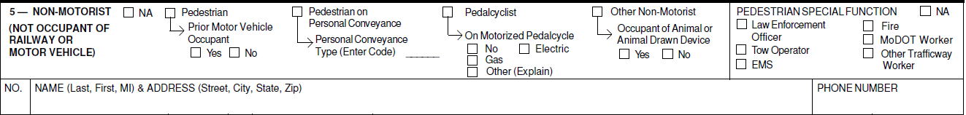
Section 5 – Non-Motorist (Not Occupant of Railway or Motor Vehicle)
Pg. 56, item g., NO. – The unique number assigned to the non-motorist.

Slide 62
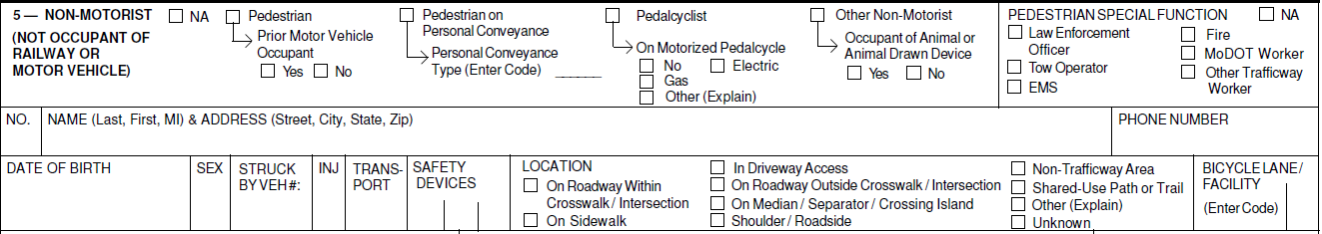
Section 5 – Non-Motorist (Not Occupant of Railway or Motor Vehicle)
Pg. 57, item p., SAFETY DEVICES: Enter up to three codes to indicate the type of safety device(s) used, if any, by the non-motorist.

Slide 63
Section 5 – Non-Motorist (Not Occupant of Railway or Motor Vehicle)
Pgs. 57 & 58, item q., LOCATION: Removed the following attribute values:
On Roadway
Off Roadway
On Median / Crossing Island

Slide 64
Section 5 – Non-Motorist (Not Occupant of Railway or Motor Vehicle)
Pgs. 57 & 58, item q., LOCATION: Added the following attribute values:
On Roadway Within Crosswalk / Intersection
On Roadway Outside Crosswalk / Intersection

Slide 65
Section 5 – Non-Motorist (Not Occupant of Railway or Motor Vehicle)
On Median / Separator / Crossing Island
Shoulder / Roadside

Slide 66
Section 5 – Non-Motorist (Not Occupant of Railway or Motor Vehicle)
Non-Trafficway Area
Shared-Use Path or Trail
Other (Explain)

Slide 67
Section 5 – Non-Motorist (Not Occupant of Railway or Motor Vehicle)
Pg. 58, item r., BICYCLE LANE / FACILITY: New field.

Slide 68
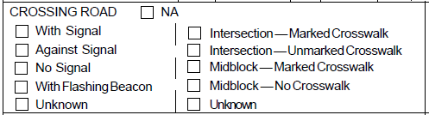
Section 5 – Non-Motorist (Not Occupant of Railway or Motor Vehicle)
Pg. 59, item ii., 4., CROSSING ROAD: Added attribute value With Flashing Beacon.

Slide 69
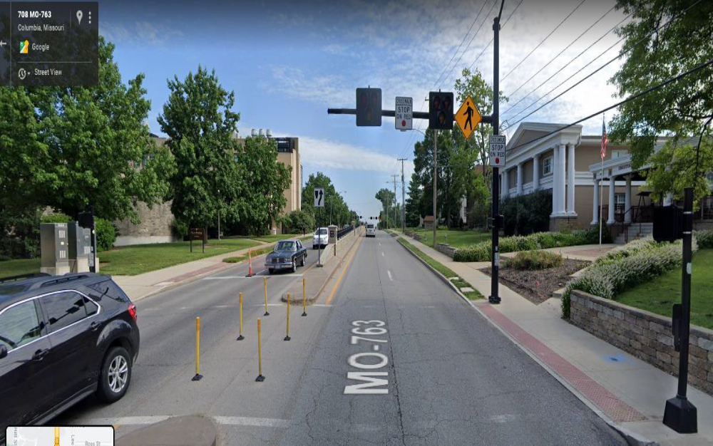
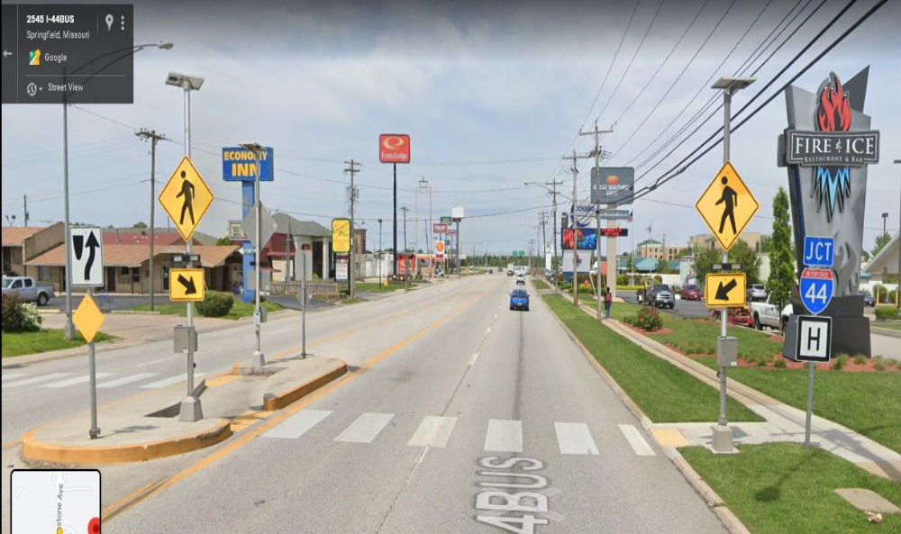
Section 5 – Non-Motorist (Not Occupant of Railway or Motor Vehicle)
Pg. 59, CROSSING ROAD: Added attribute value With Flashing Beacon. Examples:

Slide 70
Section 5 – Non-Motorist (Not Occupant of Railway or Motor Vehicle)
Pg. 60 items iii., 1 - 4, Crosswalk: Changed the attribute values pertaining to crosswalk.

Slide 71

Section 5 – Non-Motorist (Not Occupant of Railway or Motor Vehicle)
Pg. 60, item t., ACTIONS: Considering Section 5 is for non-motorists, we changed the attribute value Walking / Running in Trafficway to Walking / Running / Cycling / Riding in Trafficway.

Slide 72
Section 5 – Non-Motorist (Not Occupant of Railway or Motor Vehicle)
Pg. 60, item t., ACTIONS: Some of the attribute value definitions pertain to all non-motorists and some only pertain to pedestrians. Ex. Pushing / Working on Vehicle only applies to pedestrians.

Slide 73
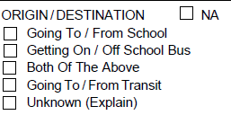
Section 5 – Non-Motorist (Not Occupant of Railway or Motor Vehicle)
Pg 61, item u., ORIGIN / DESTINATION: Added the attribute value Going To / From Transit.

Slide 74
Section 5 – Non-Motorist (Not Occupant of Railway or Motor Vehicle)
Pgs. 61 & 62, item v., PROBABLE CONTRIBUTING CIRCUMSTANCES: Considering Section 5 pertains to non-motorists, we added or modified several attribute values that relate to the various non-motorist types (Pedestrians, Pedalcyclists, Other Non-Motorists).

Slide 75
Section 5 – Non-Motorist (Not Occupant of Railway or Motor Vehicle)
Pgs. 61 & 62, PROBABLE CONTRIBUTING CIRCUMSTANCES: They include:
Failure to Obey Traffic Signs, Signals, or Officer
Improper Lane Usage / Change

Slide 76
Section 5 – Non-Motorist (Not Occupant of Railway or Motor Vehicle)
Pgs. 61 & 62, PROBABLE CONTRIBUTING CIRCUMSTANCES: They include:
Wrong Way
Not Visible (Dark Clothing, No Lighting, etc.)
Improper Turn

Slide 77
Section 5 – Non-Motorist (Not Occupant of Railway or Motor Vehicle)
Pgs. 61 & 62, PROBABLE CONTRIBUTING CIRCUMSTANCES: They include:
Improper Passing
Improper Signal
Improper Backing

Slide 78
Section 5 – Non-Motorist (Not Occupant of Railway or Motor Vehicle)
Pgs. 61 & 62, PROBABLE CONTRIBUTING CIRCUMSTANCES: They include:
Following Too Close
Improper Start from Park
In Roadway Improperly (Standing, Lying, Working, Playing, Stopped)

Slide 79
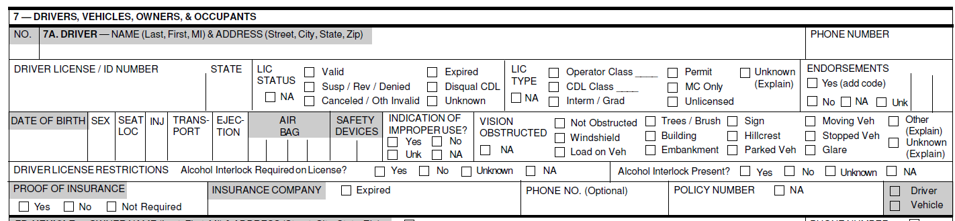
Section 7 – DRIVERS, VEHICLES, OWNERS, & OCCUPANTS
Pg. 66, Item VII. (top of page).

Slide 80
Section 7 – DRIVERS, VEHICLES, OWNERS, & OCCUPANTS
Pg. 66, item a., NO. - (Number) The vehicle driver or operator number assigned by the investigator. (We removed “Other Transport Device” from the definition.)

Slide 81
Section 7 – DRIVERS, VEHICLES, OWNERS, & OCCUPANTS
Pg. 68, item viii., ENDORSEMENTS: We changed this field from MC Endorsement to Endorsements. Applies to all types of driver license endorsements. Up to two endorsement codes can be entered. If more than two endorsement codes on a driver’s license, try to select the codes that best relate to the type of vehicle operated in the crash.

Slide 82
Section 7 – DRIVERS, VEHICLES, OWNERS, & OCCUPANTS
Pg. 69, item xv., AIR BAGS: Changed from entry of one air bag code to entry of up to four air bag codes considering the code corresponds to the specific type of air bag deployed. (Example: Front, side, curtain if all three deployed, enter the applicable code for each.)

Slide 83
Section 7 – DRIVERS, VEHICLES, OWNERS, & OCCUPANTS
Pg. 70, item xvi., INDICATION OF IMPROPER USE?: New field and relates to use of Safety Devices by the driver.

Slide 84
Section 7 – DRIVERS, VEHICLES, OWNERS, & OCCUPANTS
Pg. 71, item xviii., DRIVER LICENSE RESTRICTIONS: New fields added.
Alcohol Interlock Required on License?
Alcohol Interlock Present?

Slide 85
Section 7 – DRIVERS, VEHICLES, OWNERS, & OCCUPANTS
Pg. 72, item xx., INSURANCE COMPANY: Provided some clarification on entering insurance company name in cases where proof of insurance is not required and entry of “NA”- not applicable.

Slide 86
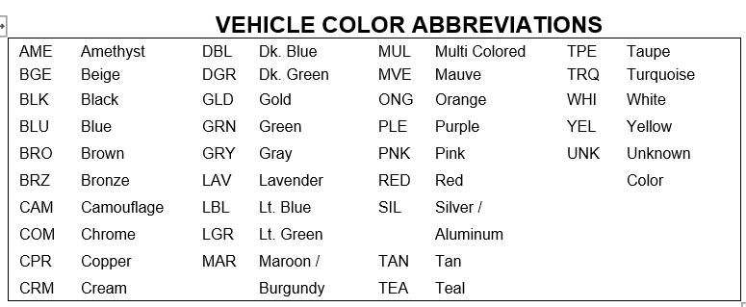
Section 7B. VEHICLE
Pgs. 73 and 74, item vi., VEHILCE COLOR ABBREVIATIONS: We deleted, added, and modified some of the colors on the list to follow the current NCIC standard.

Slide 87
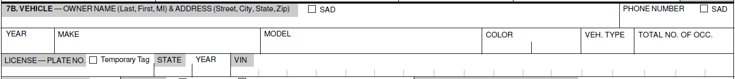
Section 7B. VEHICLE
Pgs. 74 & 75, items ix. – xii., LICENSE – PLATE NO., STATE, and YEAR:
Revised the instructions pertaining to a temporary license / permit.
Also added a checkbox for Temporary Tag.

Slide 88
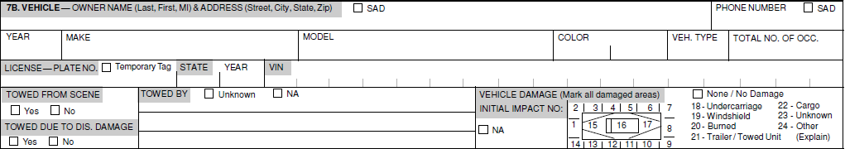
Section 7B. VEHICLE
Pg. 76, item xvii., Vehicle Damage Field we changed the attribute value Towed Unit to Trailer / Towed Unit for consistency with other related fields on the crash report.

Slide 89
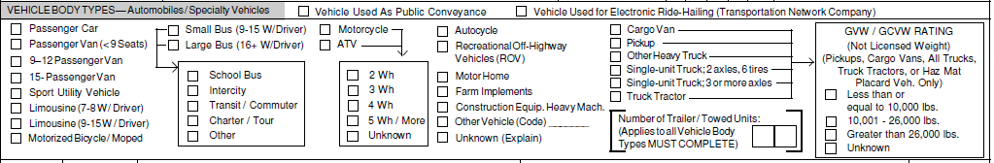
Section 7B. VEHICLE
Pgs. 76 & 77, item xviii., VEHICLE BODY TYPES: Added a new attribute value for Vehicle Used for Electric Ride-Hailing (Transportation Network Company.)

Slide 90
Section 7B. VEHICLE
Pgs. 77 - 81, VEHICLE BODY TYPES: Added or modified the following attribute values:
Passenger Van (< 9 Seats)
9-12 Passenger Van
15-Passenger Van

Slide 91
Section 7B. VEHICLE
Pgs. 77 - 81, VEHICLE BODY TYPES: Added or modified the following attribute values:
Motorized Bicycle / Moped
Autocycle
Recreational Off-Highway Vehicles (ROV)

Slide 92
Section 7B. VEHICLE
Pgs. 77 - 81, VEHICLE BODY TYPES:
Removed attribute values Truck Tractor With No Units thru Truck Tractor With Three Units and changed to Truck Tractor.
Replaced with Number of Trailer / Towed Units.
  Applies to ALL vehicle body types
  Must be completed

Slide 93
Section 7B. VEHICLE
Pgs. 77 - 81, VEHICLE BODY TYPES:
Enter “NA” if there are no trailer/towed units attached to the vehicle and “U” if unknown.

Slide 94
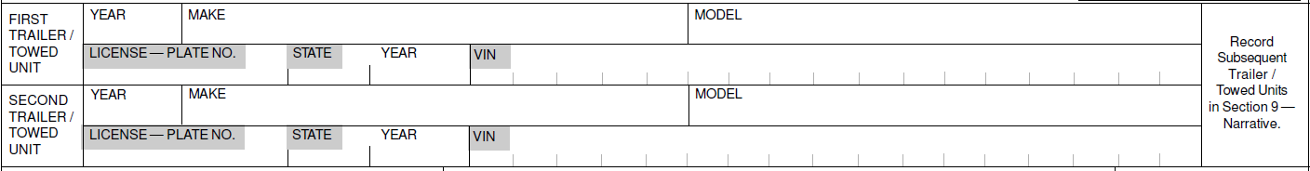
Section 7B. VEHICLE
Pg. 82, item xix., FIRST & SECOND TRAILER / TOWED UNIT: Added to the report to record specific information on the trailer or towed unit(s).
These fields are completed anytime a trailer or towed unit is attached to a vehicle regardless if the trailer or towed unit is damaged or not. Completed also if the unit is disengaged from the power unit.

Slide 95
Section 7B. VEHICLE
In the event the trailer or towed unit is damaged, then 21 – Trailer / Towed Unit will be circled in the Vehicle Damage field.
Crashes involving vehicles with more than two trailer/towed units attached, information on the third or subsequent unit(s) (year, make, model, VIN, etc.) will be recorded in Section 9 – NARRATIVE STATEMENTS.

Slide 96
Section 7B. VEHICLE
Pg. 83, item xx., AUTOMATION SYSTEM OR SYSTEMS IN VEHICLE: New field (from MMUCC).
Hardware and software that are collectively capable of performing part or all of the dynamic driving task on a sustained basis. (See SAE International’s Levels of Driving Automation – 2014.)

Slide 97
Section 7B. VEHICLE
Pg. 83, Dynamic Driving Task.

Slide 98
Section 7B. VEHICLE
Pg. 83,
Using the Levels of Driving Automation chart on pg. 85, determine if the vehicle is equipped with an Automation System or Systems.
If marked “Yes,” complete the AUTOMATION SYSTEM LEVELS ENGAGED AT TIME OF CRASH and DRIVER CEDED CONTROL fields.

Slide 99
Section 7B. VEHICLE
Pg. 83,
If marked “No,” do not complete AUTOMATION SYSTEM LEVELS ENGAGED AT TIME OF CRASH and DRIVER CEDED CONTROL fields.

Slide 100
Section 7B. VEHICLE
Pg. 84, item xxi., AUTOMATION SYSTEM LEVELS ENGAGED AT TIME OF CRASH: New field,
Use the Levels of Driving Automation chart on pg. 85 as a guide.
Probably going to have to rely on the vehicle driver and/or occupants to obtain the info.

Slide 101
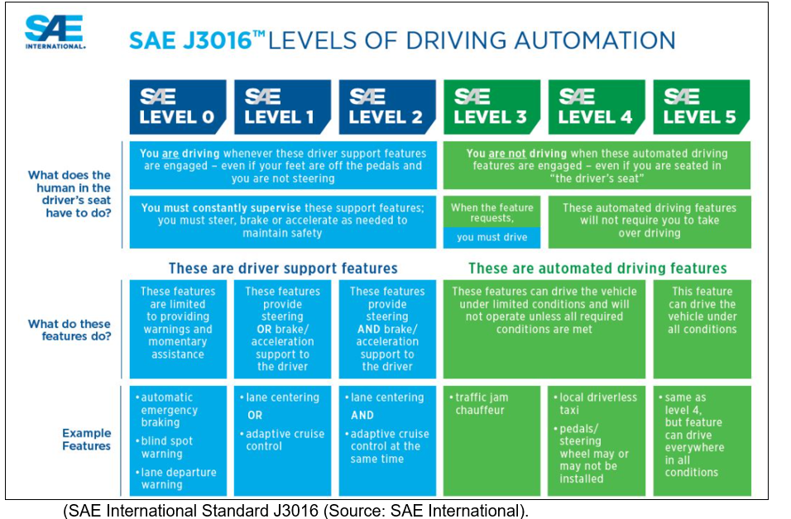
Section 7B. VEHICLE
Pg. 85, SAE J3016 International’s Levels of Driving Automation

Slide 102
Section 7B. VEHICLE
Pg. 85, item xxii., DRIVER CEDED CONTROL. New field.

Slide 103

Section 7B. VEHICLE
Pg. 85, item xxiii., EMERGENCY VEHICLE INVOLVEMENT, clarified box “A.” OR “B.” must be marked if “Other” is marked.

Slide 104
Section 7C. VEHICLE ACTION / SEQUENCE OF EVENTS CODES
Pg. 86, item 7C, We clarified that the sequence of events ends with the final rest or the end of the unstabalized event(s).

Slide 105
Section 7C. VEHICLE ACTION / SEQUENCE OF EVENTS CODES
Pg. 87, item vi., with the expansion of legalized marijuana, MARIJUANA USE field was added to the crash report.

Slide 106
Section 7D. PROBABLE CONTRIBUTING CIRCUMSTANCES
Pg. 88, item 7D, PROBABLE CONTRIBUTING CIRCUMSTANCES: Changed the field from attribute values with checkboxes to entry of codes for the applicable value.

Slide 107
Section 7E. WORK ZONE
Pg. 88, item 7E, added the definition of Work Zone Related. (Relates to the “Location Of The Crash” field.)

Slide 108
Section 7E. WORK ZONE
Pg. 89, item ii., Workers Present: Added wording “This includes workers in or on a working motor vehicle, equipment, etc. or off such devices (standing on their feet, sitting, lying, etc.).

Slide 109
Section 7E. WORK ZONE RELATED
Pg. 90, item iii., TYPE OF WORK ZONE: New field that identifies the type of work zone in relation to the motor vehicle crash.

Slide 110
Section 7E. WORK ZONE RELATED
Pg. 90, LOCATION OF THE CRASH: New field that identifies the location of the crash in association with the work zone area (i.e., work zone-related).
Use the illustration on page 91 as a guide.

Slide 111
Section 7E. WORK ZONE RELATED
Pg. 91, item v., LAW ENFORCEMENT PRESENT: New field that identifies if the crash occurred within a work zone and law enforcement was present.

Slide 112
Section 7F. TRAFFIC CONTROL
Pg. 91, item 7F., TRAFFIC CONTROL,
Made Traffic Control a separate field.
Pg. 92, item iii., 1., Electric - Green/Yellow/ Red: Added
wording that this includes solid and flashing yellow
arrows.

Slide 113
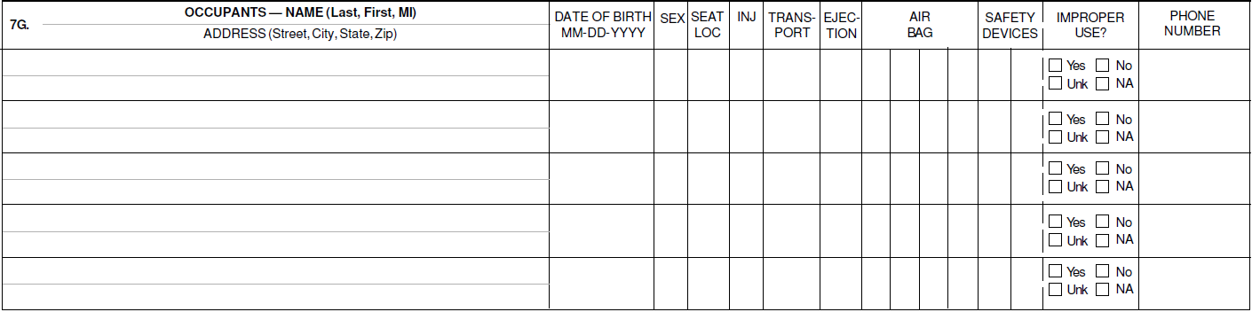
Section 7G. OCCUPANT INFORMATION
Pg. 96, item ix., AIR BAG: Changed from entry of one air bag code to entry of up to four air bag codes considering the code corresponds to the specific type of air bag deployed. (Example: Front, side, curtain if all three deployed, enter the applicable code for each.)

Slide 114
Section 7G. OCCUPANT INFORMATION
Pg. 96, item xi., IMPROPER USE?: New field pertaining to SAFETY DEVICES used by the vehicle occupant.

Slide 115
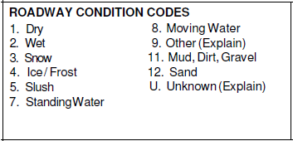
Section 8 - CODES
Pg. 102, item a., ROADWAY CONDITION CODES: Changed attribute values Mud / Dirt and Sand / Gravel to 11. Mud, Dirt, Gravel and 12. Sand.

Slide 116
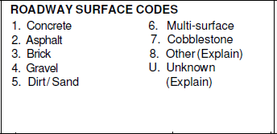
Section 8 - CODES
Pg. 103, item b., ROADWAY SURFACE: Added attribute value 8. Other (Explain).

Slide 117
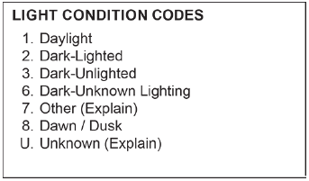
Section 8 - CODES
Pgs. 103 & 104, item c., LIGHT CONDITION: Added attribute value 8. Dawn / Dusk.

Slide 118
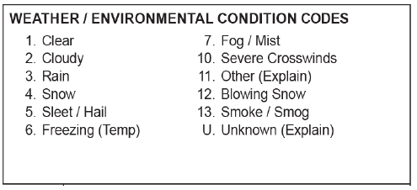
Section 8 - CODES
Pgs. 104 & 105, item d., WEATHER / ENVIRONMENTAL CONDITIONS: Added the attribute values 12. Blowing Snow and 13. Smoke and Smog.

Slide 119
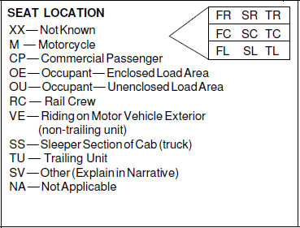
Section 8 - CODES
Pgs. 105 & 106, item e., SEAT LOCATION: Added the following attribute values:
VE – Riding on Motor Vehicle Exterior (non-trailing unit)

Slide 120
Section 8 - CODES
SS – Sleeper Section of Cab (truck)
TU – Trailing Unit

Slide 121
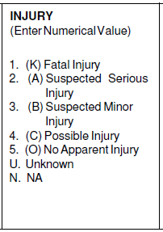
Section 8 - CODES
Pgs. 106 & 107, item f., INJURY: Changed some of the attribute values to the following:
3. (B) Suspected Minor Injury

Slide 122
Section 8 - CODES
4. (C) Possible Injury
5. (O) No Apparent Injury

Slide 123
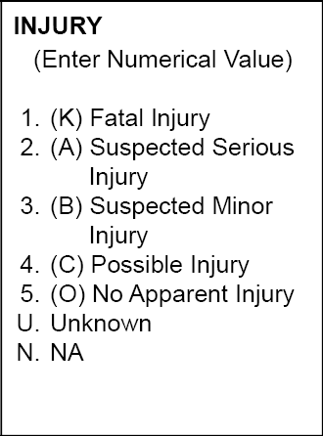
Section 8 - CODES
Note: The letters in parentheses represent the respective KABCO abbreviation and should not be used as injury codes.

Slide 124
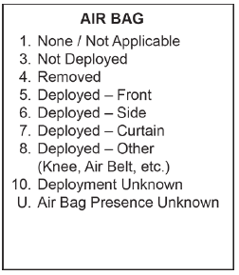
Section 8 - CODES
Pgs. 109 & 110, item i., AIR BAG: Removed the attribute value Deployed Combination.

Slide 125
Section 8 - CODES
Up to four codes can be entered to indicate the status of the air bag for each vehicle occupant. Multiple air bags may be available for an occupant’s seated position.

Slide 126
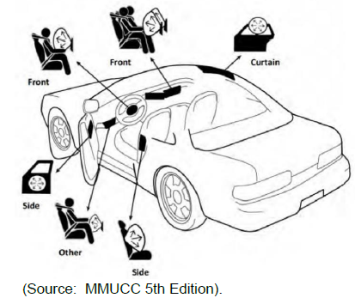
Section 8 - CODES
Revised the definitions for 5. Deployed – Front, 6. Deployed – Side, and 7. Deployed – Curtain and provided a graphic from MMUCC.

Slide 127
Section 8 - CODES
Air bag codes refer to the seated position of listed occupants, not the overall deployment of the device within the vehicle.

Slide 128
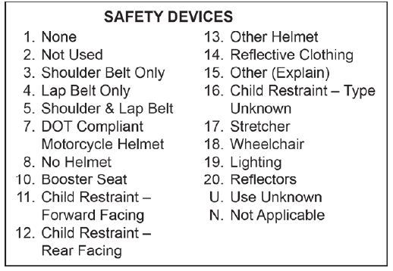
Section 8 - CODES
Pgs. 110 - 112, item j., SAFETY DEVICES: Added the following attribute values:
16. Child Restraint – Type Unknown

Slide 129
Section 8 - CODES
17. Stretcher
        Stretcher Restraining System
        Stretcher Retention System

Slide 130
Section 8 - CODES
18. Wheelchair
        Wheelchair Restraining System
        Wheelchair Retention System

Slide 131
Section 8 - CODES
19. Lighting
20. Reflectors

Slide 132
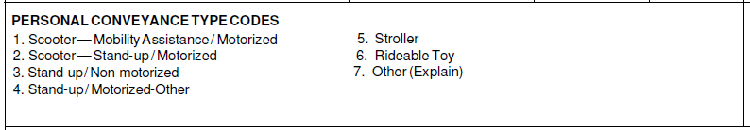
Section 8 - CODES
Pgs. 112 – 114, item k., PERSONAL CONVEYANCE TYPE CODES: New field with the following attribute values:
1. Scooter – Mobility Assistance / Motorized

Slide 133
Section 8 - CODES
2. Scooter – Stand-up / Motorized
3. Stand-up / Non-motorized
4. Stand-up / Motorized-Other

Slide 134
Section 8 - CODES
5. Stroller
6. Rideable Toy
7. Other (Explain)

Slide 135
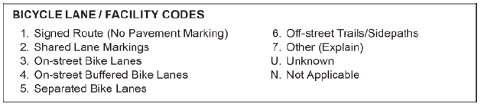
Section 8 - CODES
Pgs. 114 & 115, item i., BICYCLE LANE / FACILITY CODES: New field with the following attribute values; (We also included if each lane of facility would be on or off the roadway.)
1. Signed Route (No Pavement Marking)

Slide 136
Section 8 - CODES
2. Shared Lane Markings
3. On-Street Bike Lanes
4. On-Street Buffered Bike Lanes (Correction to Preparation Manual. First Sentence should be “Off roadway” versus “On roadway”.)

Slide 137
Section 8 - CODES
5. Separated Bike Lanes
6. Off-street Trails/Sidepaths
7. Other (Explain)

Slide 138
Section 8 - CODES
U. Unknown
N. Not Applicable

Slide 139
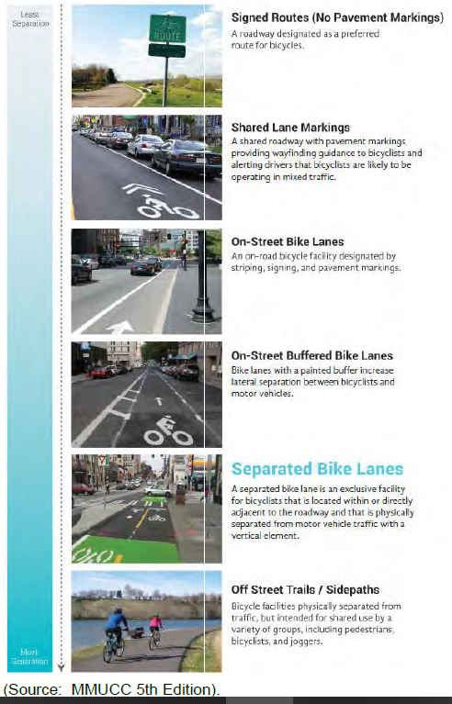
Section 8 - CODES
Use the illustration on page 115 as a guide.

Slide 140
Section 8 - CODES
Pgs. 116 & 117, item n., ENDORSEMENT CODES:
(Reminder, more than two endorsement codes may appear on a driver’s license. Use the codes that apply to the type of vehicle the driver was operating that was involved in the crash.)

Slide 141
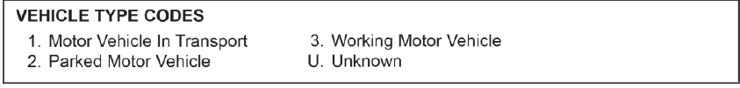
Section 8 - Codes
Pg. 117, item o., VEHILCE TYPE CODES: We removed the following since they will be recorded in Sections 3 and 5:
4. Pedalcycle
5. Animal Drawn Vehicle / Animal Ridden for Transport Purposes

Slide 142
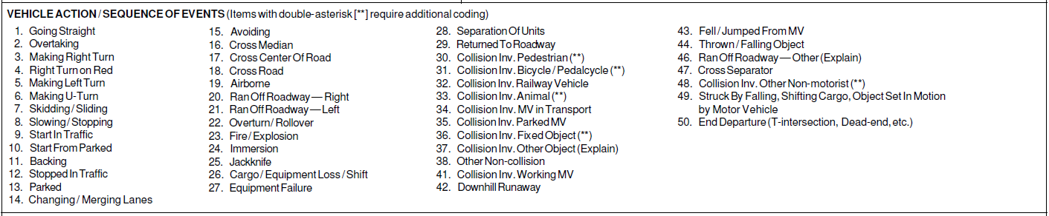
Section 8 - CODES
Pgs. 119 - 123, item q., VEHICLE ACTION / SEQUENCE OF EVENTS: Changed and added some attribute values as well as modified some of the definitions.

Slide 143
Section 8 - CODES
Pg. 119, 14. Changing / Merging Lanes
Pgs. 119 & 120, 18. Cross Road added third
example under “Excludes”.

Slide 144
Section 8 - CODES
Pg. 120, 20. Ran Off Roadway - Right

Slide 145
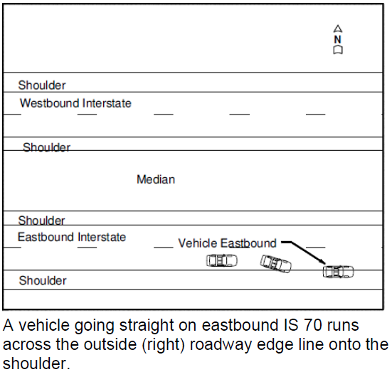
Section 8 - CODES
Pg. 120, Ran Off Roadway – Right Examples:

Slide 146
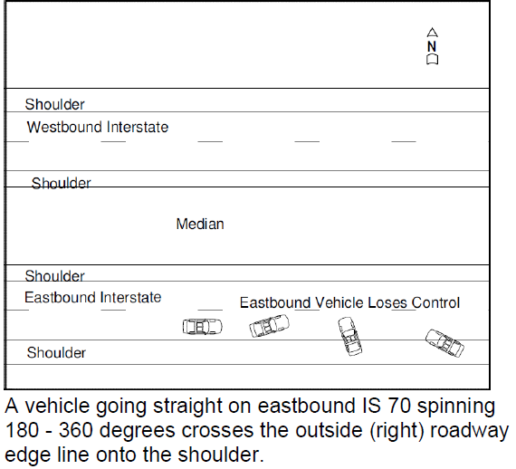
Section 8 - CODES
Pg. 120, Ran Off Roadway – Right Examples:

Slide 147
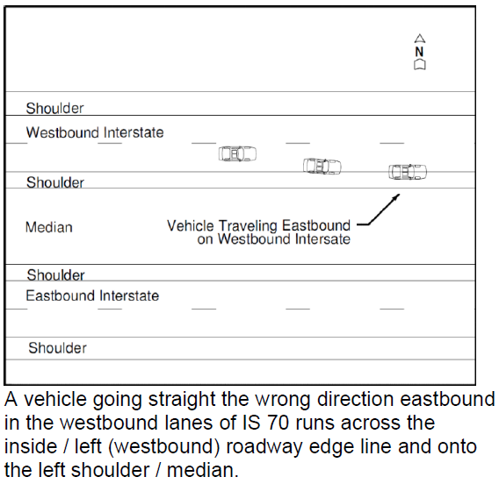
Section 8 - CODES
Pg. 120, Ran Off Roadway – Right Examples:

Slide 148
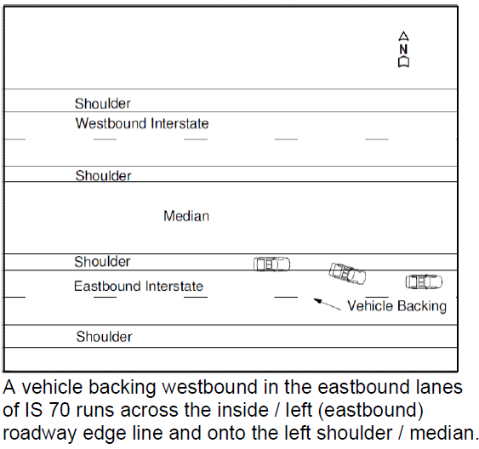
Section 8 - CODES
Pg. 120, Ran Off Roadway – Right Examples:

Slide 149
Section 8 - CODES
Pg. 120, 21. Ran Off Roadway - Left

Slide 150
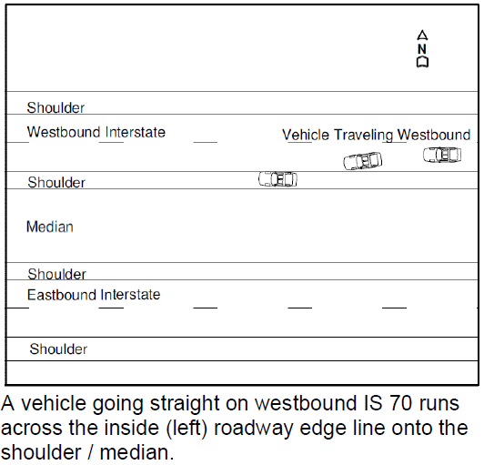
Section 8 - CODES
Pg. 121, Ran Off Roadway – Left Examples:

Slide 151
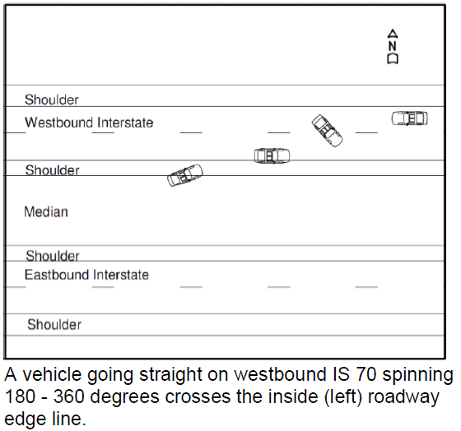
Section 8 - CODES
Pg. 121, Ran Off Roadway – Left Examples:

Slide 152
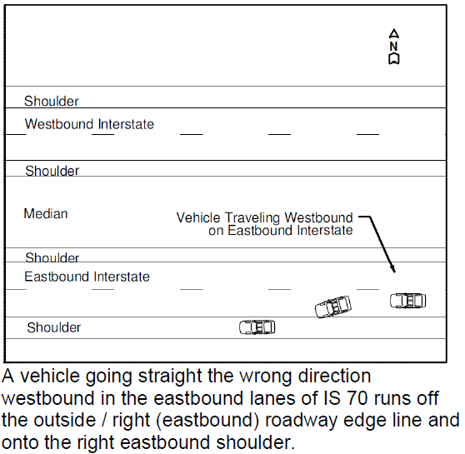
Section 8 - CODES
Pg. 121, Ran Off Roadway – Left Examples:

Slide 153
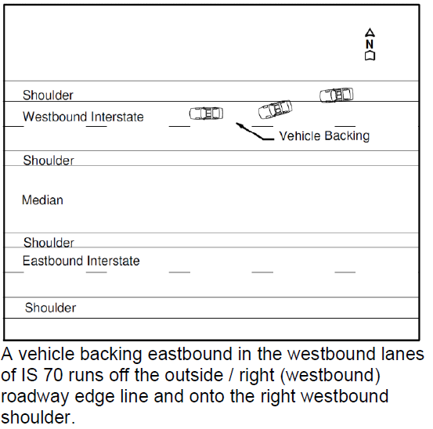
Section 8 - CODES
Pg. 121, Ran Off Roadway – Left Examples:

Slide 154
Section 8 - CODES
Pg. 121, 25. Jackknife
Pg. 122, 44. Thrown / Falling Object

Slide 155
Section 8 - CODES
Pg. 122, 46. Ran Off Roadway – Other (Explain)
Pg. 123, 48. Collision Inv. Other Non-Motorist

Slide 156
Section 8 - CODES
Pg. 123, 49. Struck by Falling, Shifting Cargo or Anything Set in Motion by Motor Vehicle
Pg. 123, 50. End Departure

Slide 157
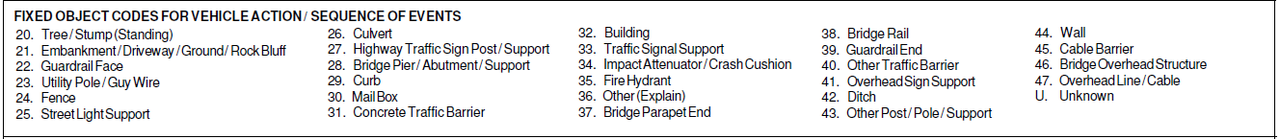
Section 8 - CODES
Pg. 124, FIXED OBJECT CODES FOR VEHICLE ACTION / SEQUENCE OF EVENTS:
23. Changed Utility Pole to Utility Pole / Guy Wire

Slide 158
Section 8 - CODES
Pg. 126, FIXED OBJECT CODES FOR VEHICLE ACTION / SEQUENCE OF EVENTS:
32. Building – Roofed and walled structure for permanent use attached to the terrain.

Slide 159
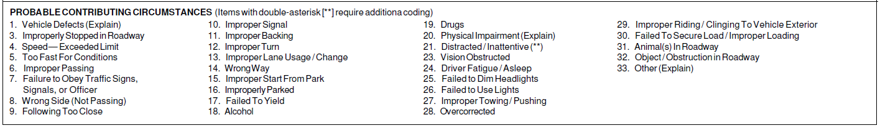
Section 8 - CODES
Pgs. 129-131, item t., PROBABLE CONTRIBUTING CIRSUMSTANCES, changed the following attributes:
Pg. 130, 7. Failure to Obey Traffic Signs, Signals, or Officer

Slide 160
Section 8 - CODES
Pg. 130, 14. Wrong Way

Slide 161
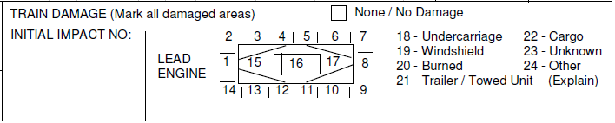
Railway Vehicle Crash Continuation/Supplement
Pg. 137, Train Damage field, we changed code 21 – Towed Unit to 21 – Trailer / Towed Unit.

Slide 162
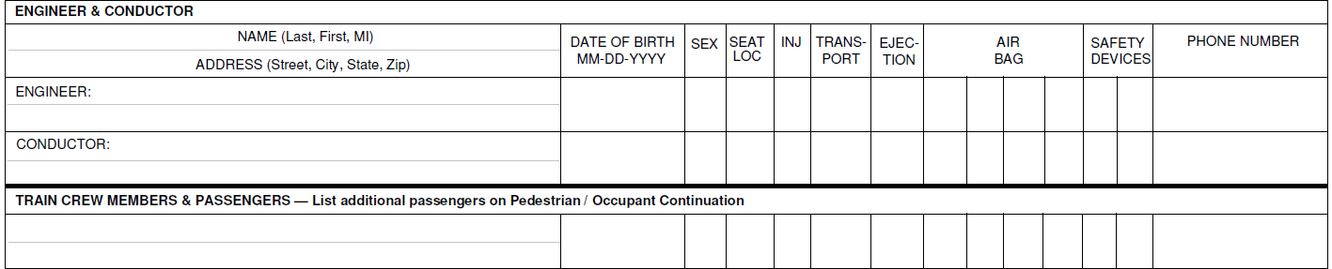
Railway Vehicle Crash Continuation/Supplement
Pgs. 146-148, item i., allowed up to four Air Bag codes for the engineer, conductor, train crew members, and passengers.

Slide 163
APPENDIX A – Short Form Information
Pg. 149, Section 1, added the following to the list of required short form fields:
Date of Rdwy. Clear
Time of Rdwy. Clear

Slide 164
APPENDIX A – Short Form Information
Pg. 149, Section 7, added the following to the list of required short form fields:
First & Second Trailer Towed Unit – License Plate No. (If applicable)
First & Second Trailer Towed Unit – State
First & Second Trailer Towed Unit – VIN
Work Zone
Type of Work Zone

Slide 165
APPENDIX A – Short Form Information
Pg. 149, Section 7, added the following to the list of required short form fields:
Location of Crash
Law Enforcement Present
Traffic Control
Control Malfunctioning / Inoperative / Missing

Slide 166
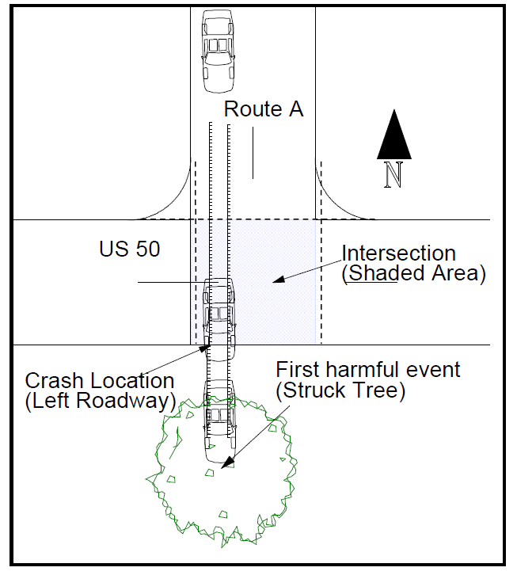
APPENDIX E – Classifying and Locating Crashes
Pgs. 169 & 170, changed the VEHICLE ACTION / SEQUENCE OF EVENTS for this crash example to include 50. End Departure instead of 46. Ran off Roadway Other.

Slide 167


APPENDIX E – Classifying and Locating Crashes
Crash “B”
Crash “C”
Pg. 176, for Crash “B” and Crash “C” we corrected the “Trafficway” field from “One-Way” to “Two-Way; Divided; Unprotected Median.

Slide 168

APPENDIX E – Classifying and Locating Crashes
Pg. 199, changed the “Collision Involving” from “Motor Vehicle in Transport” to “Parked Motor Vehicle” based on the changes to the definition of “Motor Vehicle in Transport” and inclusions to “Parked Motor Vehicle” in the Glossary.

Slide 169
Questions?

Slide 170
Access To The MUCR Revision PowerPoint Presentation
Access the Missouri State Highway Patrol’s website: statepatrol.dps.mo.gov. Or, Google Missouri State Highway Patrol.
Scroll to the bottom of the home page.

Slide 171

Access To The MUCR Revision PowerPoint Presentation
Under the “Publications” heading, select the “Handbooks and Manuals” icon.

Slide 172

Access To The MUCR Revision PowerPoint Presentation
Scroll to the bottom of the page.
Under the “Patrol Records” heading, select “2024 MUCR Revision Training PowerPoint.”
2024 MUCR Revision Training PowerPoint

Slide 173

Contacts
Mandy Kliethermes: Phone (573) 751-3012
email: Mandy.Kliethermes@mshp.dps.mo.gov
Maria Fooks: Phone (573) 526-6113, ext. 1734
email: Maria.Fooks@mshp.dps.mo.gov
Terry Kampeter: Phone (572) 526-6113, ext. 1731
email: Theresa.Kampeter@mshp.dps.mo.gov
Address: Missouri State Highway Patrol
Patrol Records Division
P.O. Box 568
Jefferson City, MO 65102

